Slide 1

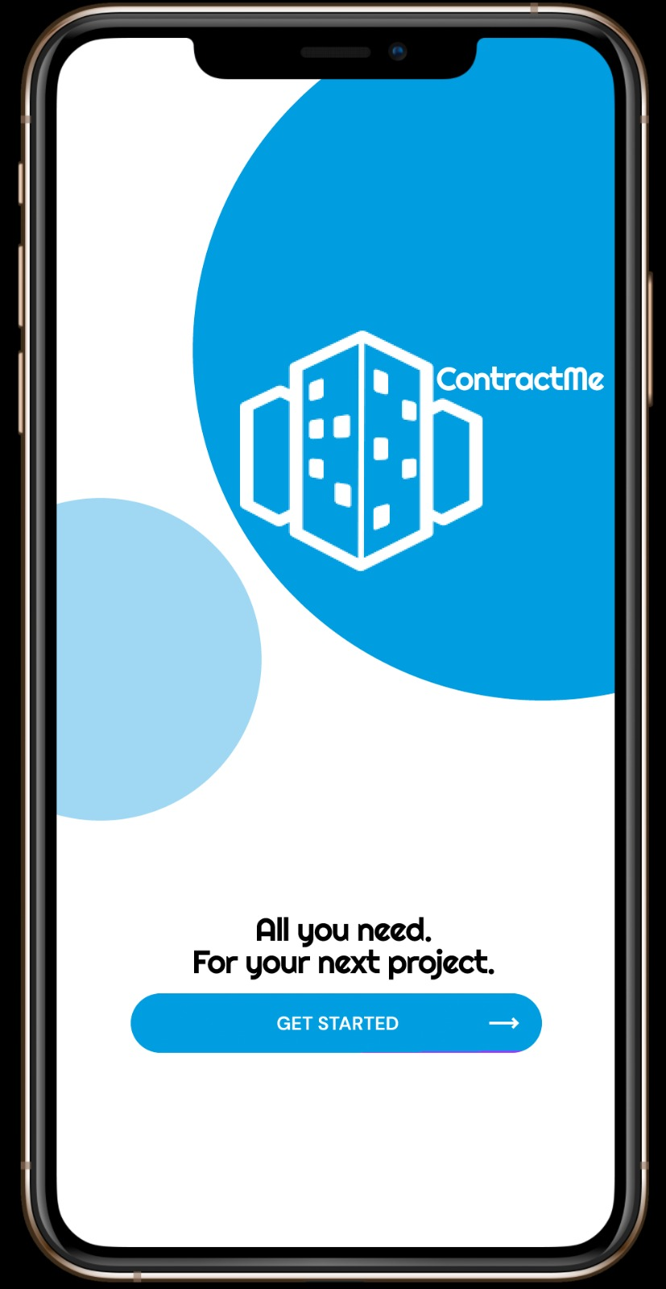
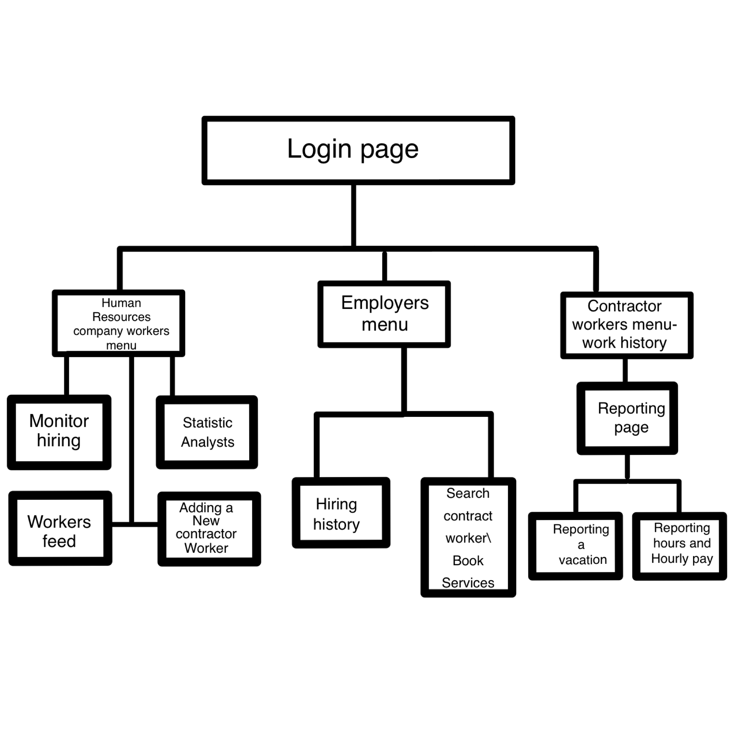
contract me
Established for a human resources company for simple and efficient management of contractor workers hiring and linking with employers.
Technical
support
Edit info

Slide 2
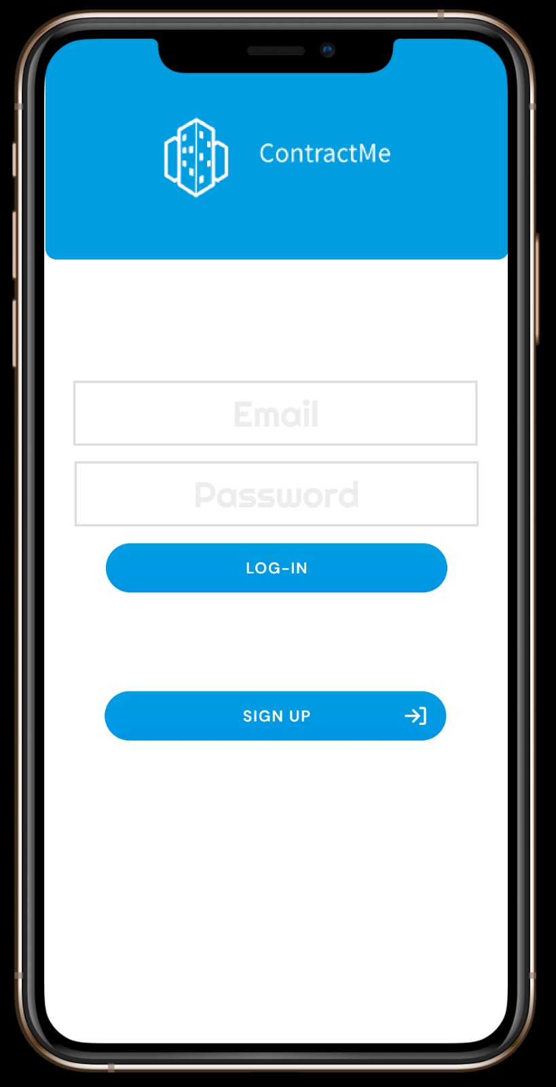
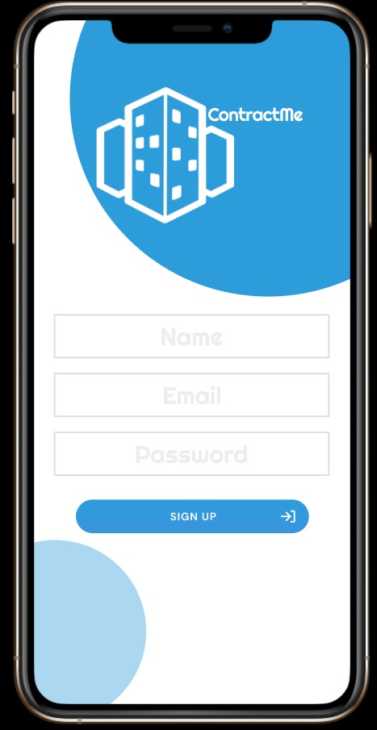
Login & sign up page
There is a possibility to sign up as new employer. Clicking on the option will take you to the registration screen which there you can fill in personal details.
After the user logs in, the system automatically detects the type of the user and forwards him to the appropriate menu.
Technical
support
Edit info

Slide 3
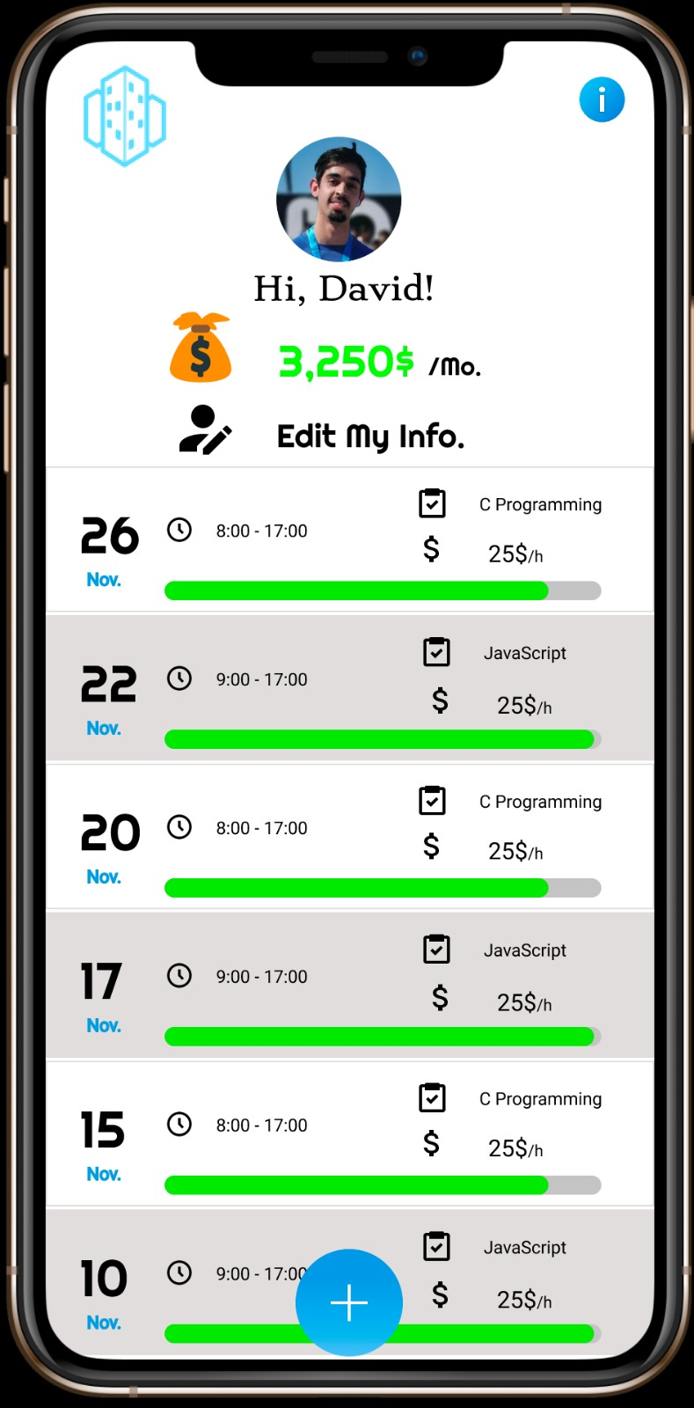
Contractor workers – main page
Work history page.
Monthly salary.
Technical
support
Edit info

Slide 4
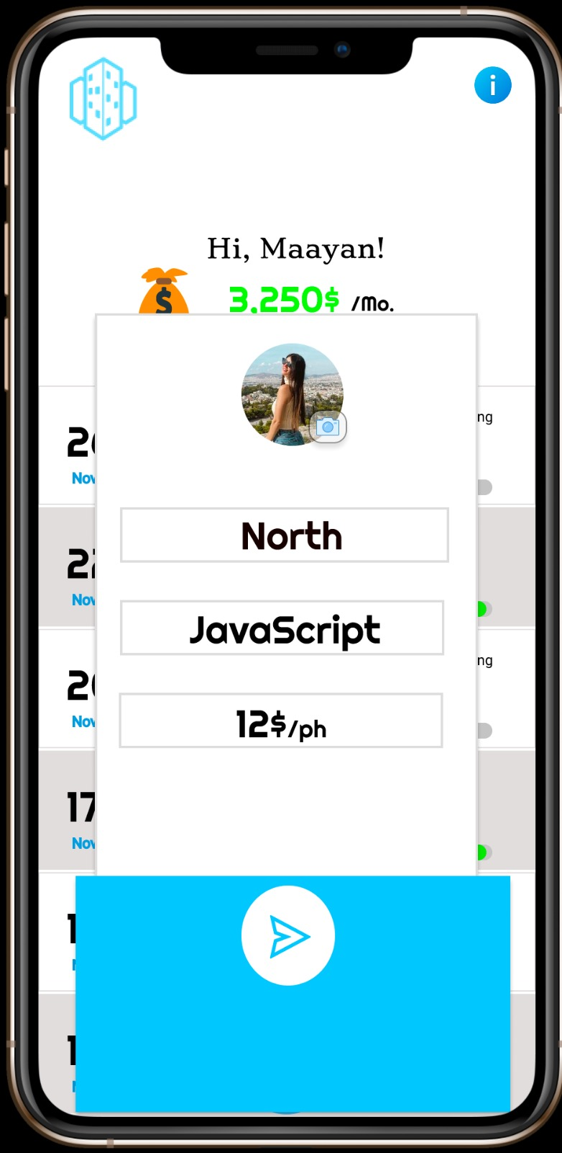
Edit my info
The contractor has the option to change the city where he lives, the hourly wage he does and his skills.
Technical
support
Edit info

Slide 5
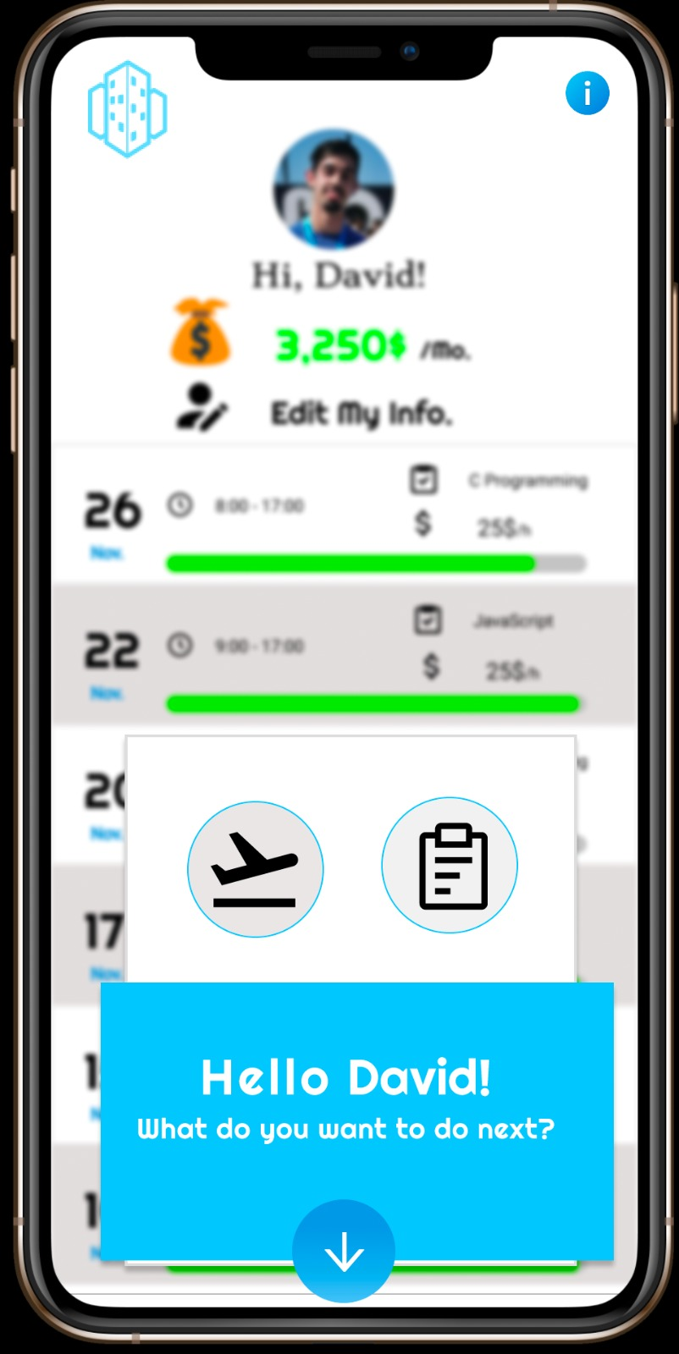
Reporting page
Choose between reporting a vacation or work day.
Technical
support
Edit info

Slide 6
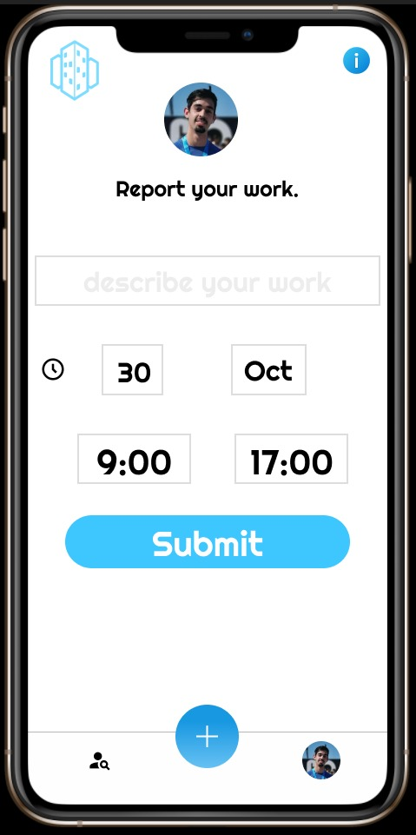
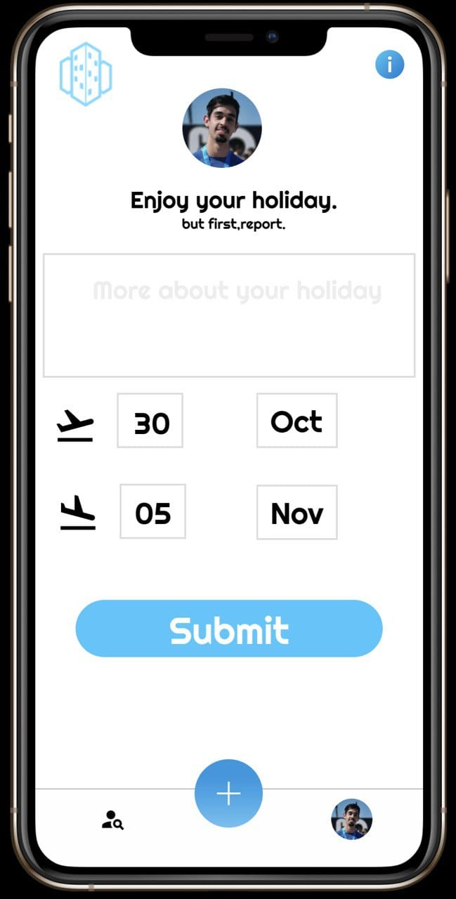
reporting a vacation
reporting work hours and hourly pay
Technical
support
Edit info

Slide 7
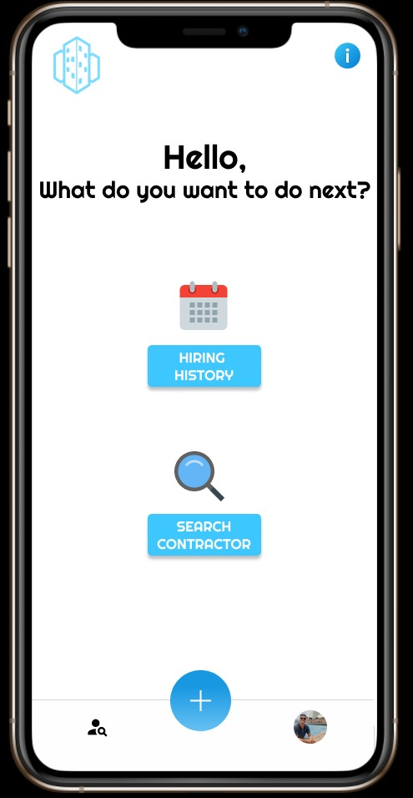
Employers menu
Technical
support
Edit info

Slide 8
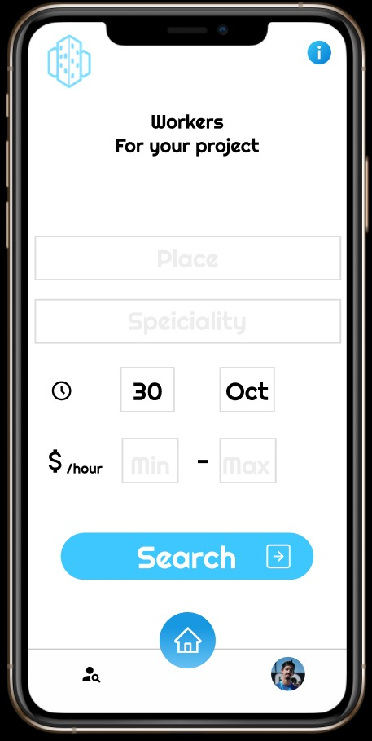
Search contractor worker
Technical
support
Edit info

Slide 9
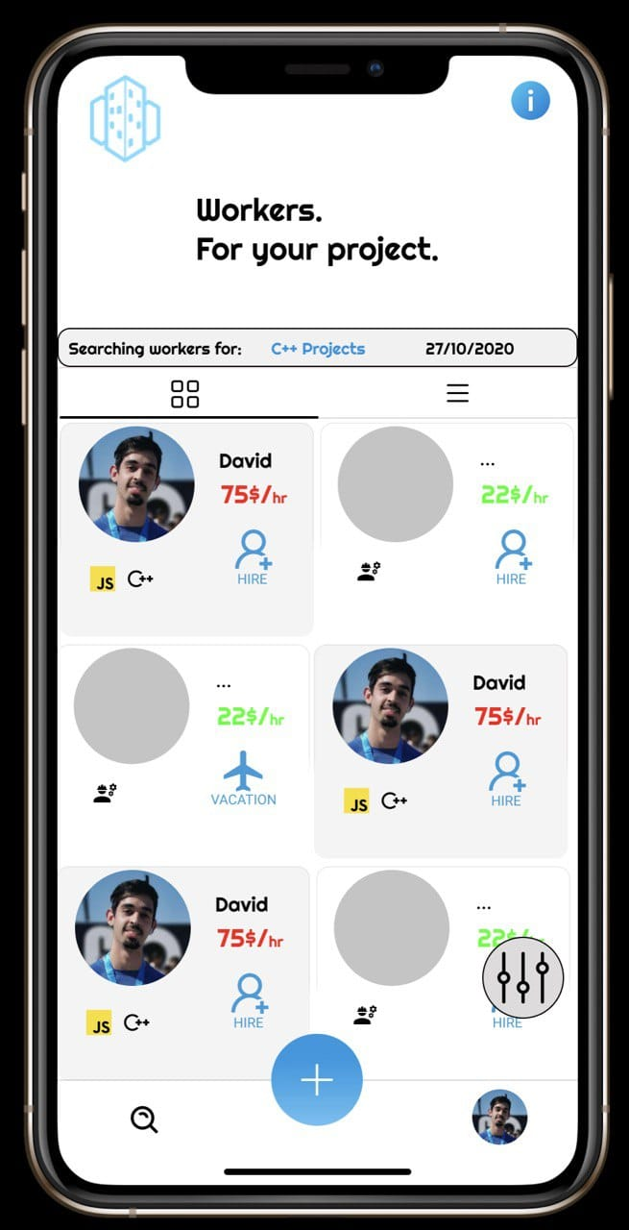
Searching results & book services
Technical
support
Edit info

Slide 10
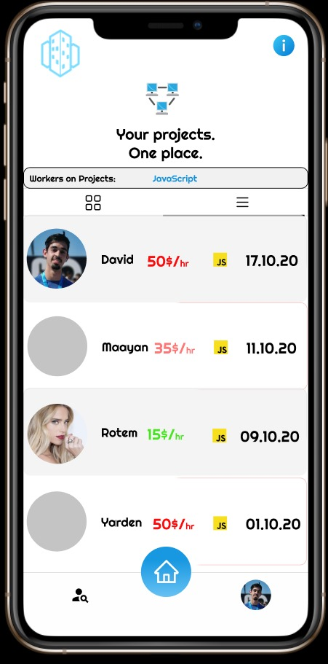
Hiring history
Technical
support
Edit info

Slide 11
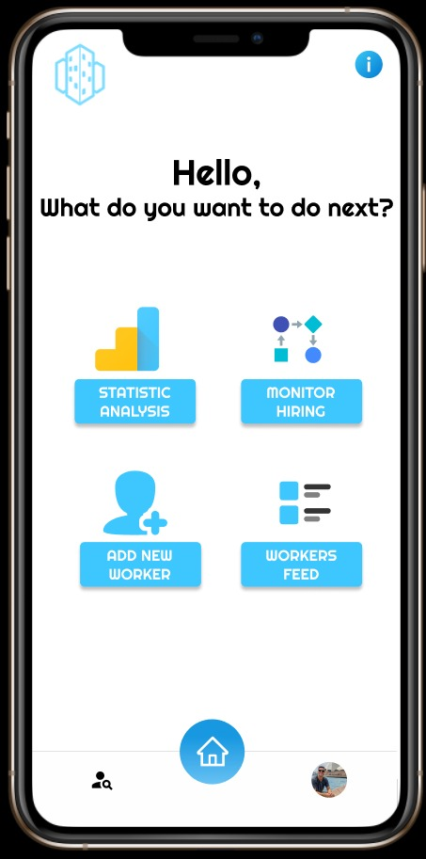
Hr company workers menu
Technical
support
Edit info

Slide 12
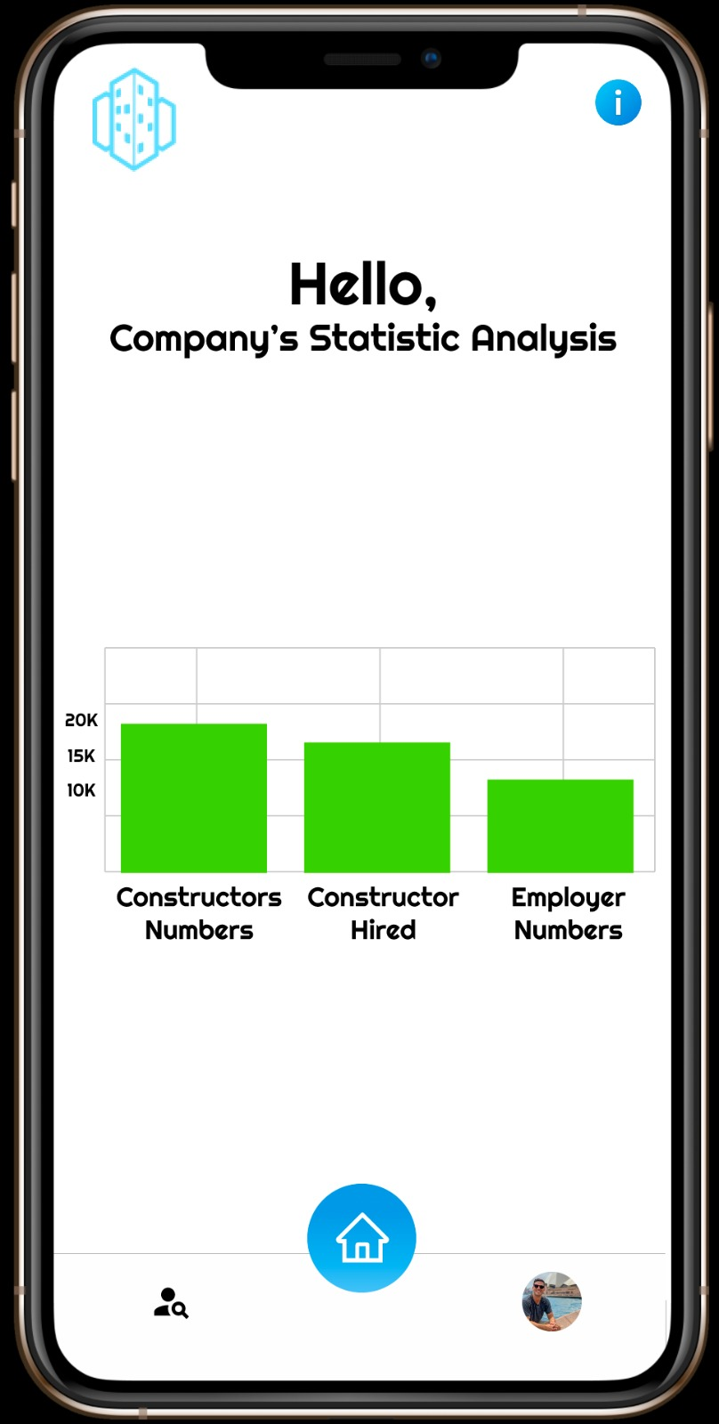
Statistic analysis
Technical
support
Edit info

Slide 13
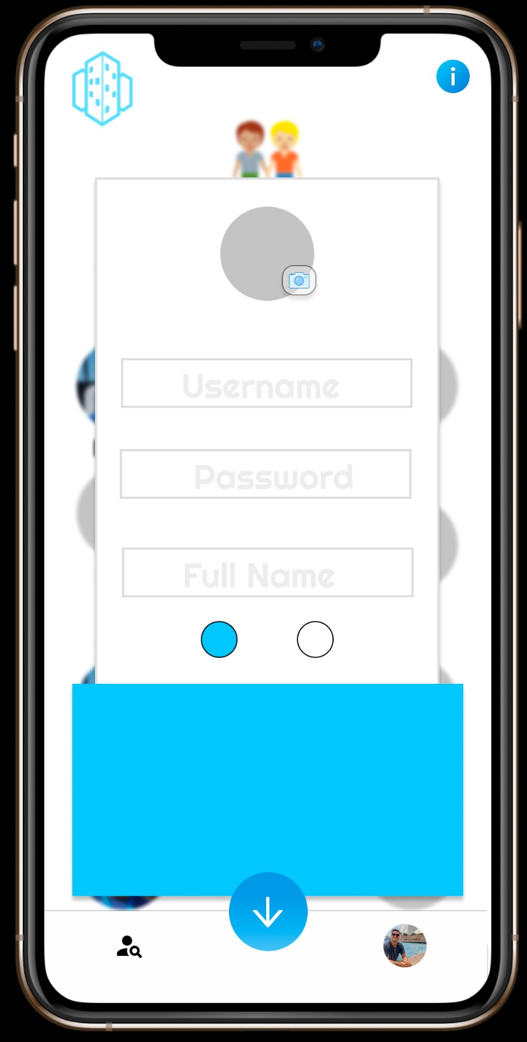
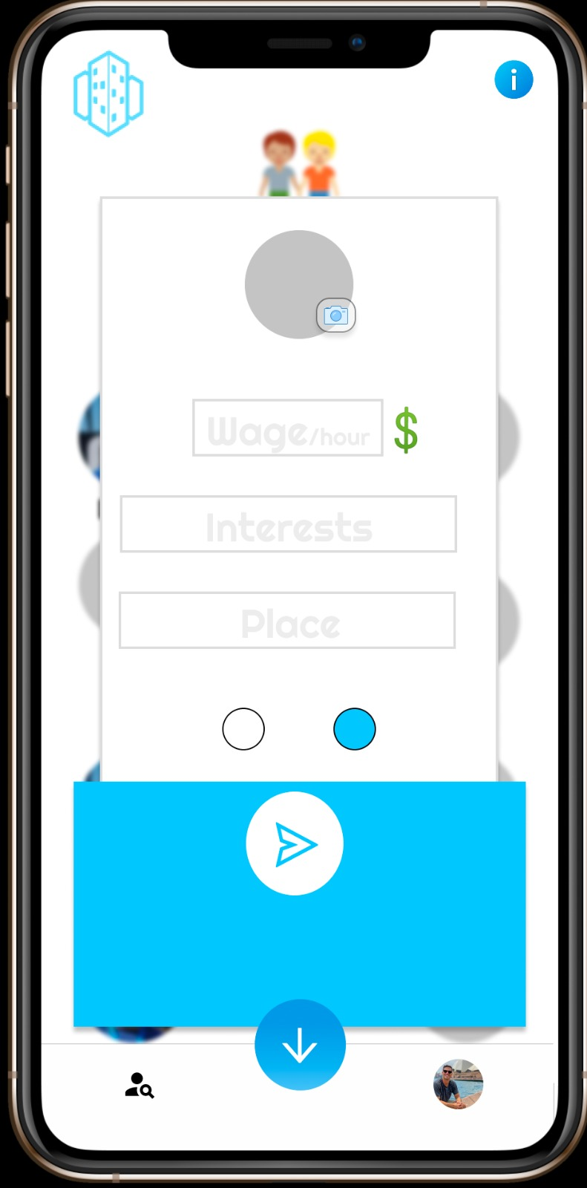
Adding a new contractor worker
Technical
support
Edit info

Slide 14
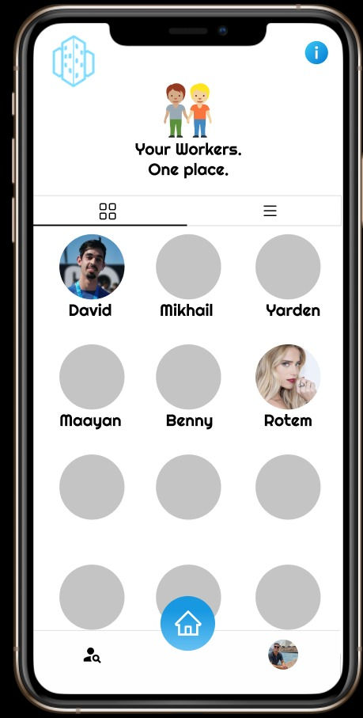
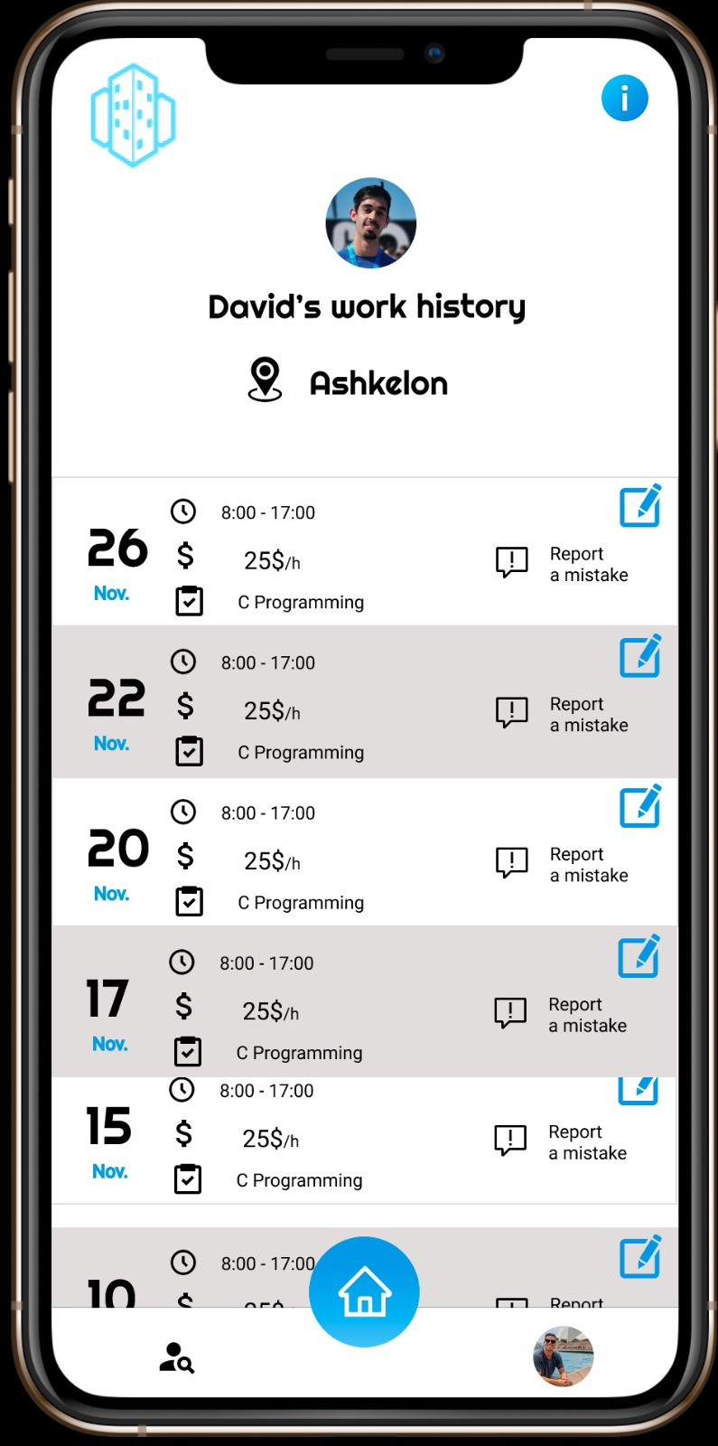
Workers feed
Technical
support
Edit info

Slide 15
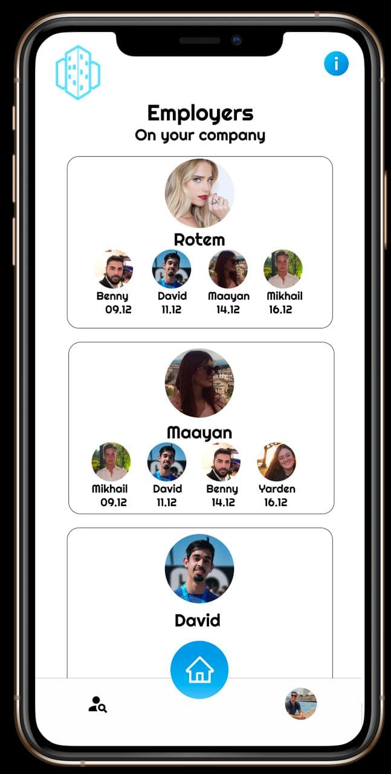
Monitor hiring
Technical
support
Edit info

Slide 16
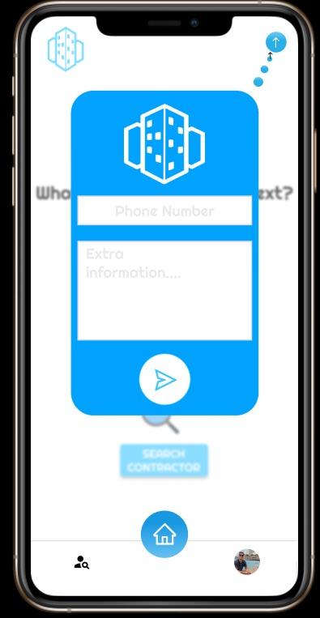

Technical Support
Bug reporting.
Contact us.
Technical
support
Edit info

Slide 17
